Slide 1
UML 1402.OOAD.L.003
CRC
CLASS DIAGRAM

Slide 2
CRC stands for
Class
Responsibilities
Collaborators

Slide 3
CRC goal
The goal:
provide the simplest possible conceptual introduction to OO modeling.

Slide 4
CRC heart
The heart of the method is the CRC card.
A CRC card is a 3-x-5" or 4-x-6" lined index card.
The physical nature of the cards emphasizes the division of responsibility across objects.
The physical size of the cards also helps to establish limits for the size and complexity of the classes.
The CRC card technique does not use the UML. Instead it is used to discover information about classes that is then placed into a UML Class diagram.
The body of the card is divided in half.
The left column/half lists the responsibilities of the class
the right column/half lists the other objects that it works with, the collaborators, to fulfill each responsibility.

Slide 5
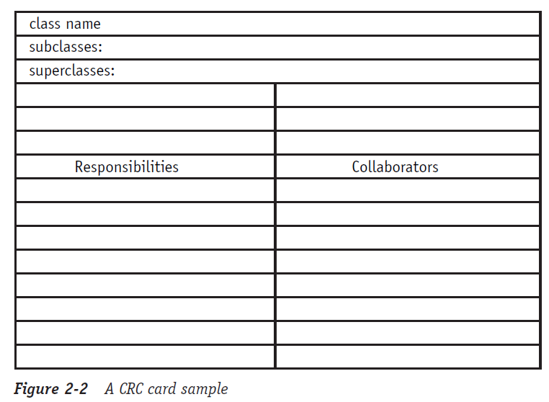
CRC sample

Slide 6
CRC process
The CRC process requires a team that includes people in two distinct roles:
domain expert
object-oriented technology facilitator.
The domain experts provide knowledge of the subject area.
The OO facilitator coaches the team through the development of the cards and the eventual model.

Slide 7
CRC process (contd.)
The CRC process centers on working through scenarios. The process breaks down into four stages:
Before the Scenario Execution
The Problem: Everyone agrees on the problem definition.
Brainstorming for Classes: Based on the problem statement, the team identifies candidate classes using the vocabulary of the problem.
Filtering Classes: The team works on definitions for each class, eliminating synonyms and conflicts.
Assigning Cards: Each team member is assigned responsibility for one or more classes.
The Scenario Execution
Each scenario expresses something that the system is supposed to do. The team walks through the scenario identifying the responsibilities of each class in the scenario.
Each discovered responsibility is recorded on the card of the corresponding class.
During the Scenario Execution
Grouping the Cards: The team identifies similar classes.
Scenario List: The team reviews the scenario coverage for completeness.
Collaboration Drawings: The cards are combined on a wall or white board to show how they cooperate in the execution of the scenarios.
After the Scenario Execution
The team reviews the resulting model and plans the implementation.

Slide 8
CRC strengths
The simplicity of the method has remained a major selling point and the method has been incorporated into many different methodologies. It is still a valuable tool for helping a programmer transition from procedural to OO concepts.
It is extremely easy to use and very visual. It is difficult for any participant to claim he didn’t know exactly what was going on.
The technique is very responsibility-driven. It keeps the participants focused on the value of an object based on what that object contributes to the proper operation of the system. The result is a system with the minimum number of objects needed to make it work.
The technique helps the participants think like objects and to understand why objects work well or work poorly. This understanding helps ensure a good design.

Slide 9
Class Diagram

Slide 10
The Class Diagram
The Class diagram represents classes, their component parts, and the way in which classes of objects are related to one another.
The Class diagram includes attributes, operations, stereotypes, properties, associations, and inheritance.

Slide 11
The Class Diagram (cntd.)
Attributes describe the appearance and knowledge of a class of objects.
Operations define the behavior that a class of objects can manifest.
Stereotypes help you understand this type of object in the context of other classes of objects with similar roles within the system’s design.
Properties provide a way to track the maintenance and status of the class definition.
Association is just a formal term for a type of relationship that this type of object may participate in. Associations may come in many variations, including simple, aggregate and composite, qualified, and reflexive.
Inheritance allows you to organize the class definitions to simplify and facilitate their implementation.

Slide 12
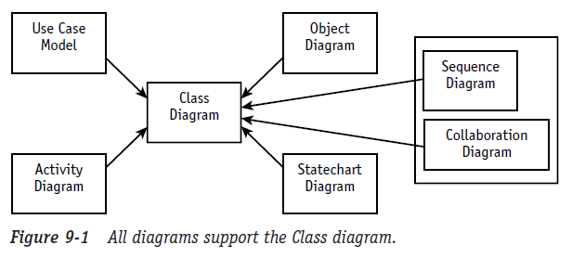
The Class Diagram (cntd.)
Although other diagrams are necessary, remember that their primary purpose is to support the construction and testing of the Class diagram.
Whenever another diagram reveals new or modified information about a class, the Class diagram must be updated to include the new information. If this new information is not passed on to the Class diagram, it will not be reflected in your code.

Slide 13
Class vs. Object Diagram
The class defines the rules; the objects express the facts.
The class defines what can be; the object describes what is.
If the Class diagram says, “This is the way things should be,” but the Object diagram graphically demonstrates that “it just ain’t so,” then you have a very specific problem to track down. The reverse is true, too.
The Object diagram can confirm that everything is working as it should.

Slide 14
The Class Diagram (cntd.)
The class symbol is comprised of three compartments (rectangular spaces) that contain distinct information needed to describe the properties of a single type of object.
The name compartment uniquely defines a class (a type of object) within a package. Consequently, classes may have the same name if they reside in different packages.
The attribute compartment contains all the data definitions.
The operations compartment contains a definition for each behavior supported by this type of object.

Slide 15
Class Diagram ::: ATTRIBUTE
An attribute describes a piece of information that an object owns or knows about itself.
Attribute visibility:
Public (+) visibility allows access to objects of all other classes.
Private (-) visibility limits access to within the class itself. For example, only operations of the class have access to a private attribute.
Protected (#) visibility allows access by subclasses. In the case of generalizations (inheritance), subclasses must have access to the attributes and operations of the superclass or they cannot be inherited.
Package (~) visibility allows access to other objects in the same package.

Slide 16
::: ATTRIBUTE
visibility / attribute name : data type = default value {constraints}
Visibility (+, -, #, ~): Required before code generation. The programming language will typically specify the valid options. The minus sign represents the visibility “private” meaning only members of the class that defines the attribute may see the attribute.
Slash (/): The derived attribute indicator is optional. Derived values may be computed or figured out using other data and a set of rules or formulas. Consequently, there are more design decisions that need to be addressed regarding the handling of this data. Often this flag is used as a placeholder until the design decisions resolve the handling of the data.

Slide 17
::: ATTRIBUTE (cntd.)
visibility / attribute name : data type = default value {constraints}
Attribute name: Required. Must be unique within the class.
Data type: Required. This is a big subject. During analysis, the data type should reflect how the client sees the data. You could think of this as the external view. During design, the data type will need to represent the programming language data type for the environment in which the class will be coded. These two pieces of information can give the programmer some very specific insights for the coding of get and set methods to support access to the attribute value.

Slide 18
::: ATTRIBUTE (cntd.)
visibility / attribute name : data type = default value {constraints}
Assignment operator and default value: Optional. Default values serve two valuable purposes. First, default values can provide significant ease-of-use improvements for the client. Second and more importantly, they protect the integrity of the system from being corrupted by missing or invalid values. A common example is the tendency to let numeric attributes default to zero. If the application ever attempts to divide using this value, you will have to handle resulting errors that could have been avoided easily with the use of a default.

Slide 19
::: ATTRIBUTE (cntd.)
visibility / attribute name : data type = default value {constraints}
Constraints: Constraints express all the rules required to guarantee the integrity of this piece of information. Any time another object tries to alter the attribute value, it must pass the rules established in the constraints. The constraints are typically implemented/enforced in any method that attempts to set the attribute value.
Class level attribute (underlined attribute declaration): Optional. Denotes that all objects of the class share a single value for the attribute. (This is called a static value in Java.)

Slide 20
Class Diagram ::: OPERATION
Objects have behaviors, things they can do and things that can be done to them. These behaviors are modeled as operations.
Operations require a name, arguments, and sometimes a return.
Arguments, or input parameters, are simply attributes, so they are specified using the attribute notation (name, data type, constraints, and default), although it is very common to use the abbreviated form of name and data type only.

Slide 21
::: OPERATION
visibility operationName ( argname : data type {constraints}, ...) : return data type {constraints}
Operation name: Required. Does not have to be unique, but the combination of name and parameters does need to be unique within a class.
Arguments/parameters: Any number of arguments is allowed. Each argument requires an identifier and a data type. Constraints may be used to define the valid set of values that may be passed in the argument. But constraints are not supported in many tools and will not be reflected in the code for the operation, at least not at this point.

Slide 22
::: OPERATION (cntd.)
visibility operationName ( argname : data type {constraints}, ...) : return data type {constraints}
Return data type: Required for a return value, but return values are optional. The UML only allows for the type, not the name, which is consistent with most programming languages. There may only be one return data type, which again is consistent with most programming languages.
Visibility (+, -, #, ~): Required before code generation. The visibility values are defined by the programming language, but typically include public (+), private (-), protected (#), and package (~).

Slide 23
::: OPERATION (cntd.)
visibility operationName ( argname : data type {constraints}, ...) : return data type {constraints}
Class level operation (underlined operation declaration): Optional. Denoted as an operation accessible at the class level; requires an instance (object) reference.
Argument name: Required for each parameter, but parameters are optional. Any number of arguments is allowed.

Slide 24
::: OPERATION (cntd.)
visibility operationName ( argname : data type {constraints}, ...) : return data type {constraints}
Argument data type: Required for each parameter, but parameters are optional.
Constraints: Optional. In general, constraints express rules that must be enforced in the execution of the operation. In the case of parameters, they express criteria that the values must satisfy before they may be used by the operation. You can think of them as operation level pre-conditions.

Slide 25
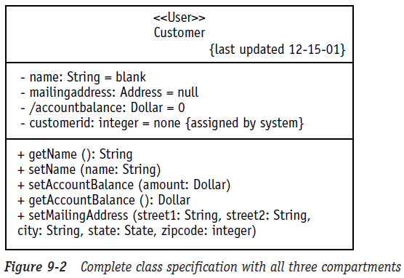
Class Diagram ::: Class Compartments
Name Compartment
Attribute Compartment
Operation Compartment

Slide 26
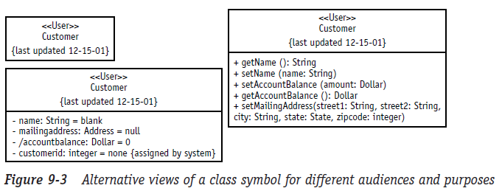
Class Diagram ::: Different Views

Slide 27
Associations
A semantic relationship between two or more classes that specifies connections among their instances.
A structural relationship, specifying that objects of one class are connected to objects of a second (possibly the same) class.
Example: “An Employee works for a Company”
Employee
Department
Company

Slide 28
Associations (cont.)
An association between two classes indicates that objects at one end of an association “recognize” objects at the other end and may send messages to them.
This property will help us discover less trivial associations using interaction diagrams.

Slide 29
Associations (cont.)
Role name
Association name
instructor
StaffMember
Student
1..*
instructs
*
Role
Navigable (uni-directional) association
Multiplicity
*
pre - requisites
Courses
0..3
Reflexive association

Slide 30
Associations (cont.)
To clarify its meaning, an association may be named.
The name is represented as a label placed midway along the association line.
Usually a verb or a verb phrase.
A role is an end of an association where it connects to a class.
May be named to indicate the role played by the class attached to the end of the association path.
Usually a noun or noun phrase
Mandatory for reflexive associations

Slide 31
Associations (cont.)
Multiplicity
The number of instances of the class, next to which the multiplicity expression appears, that are referenced by a single instance of the class that is at the other end of the association path.
Indicates whether or not an association is mandatory.
Provides a lower and upper bound on the number of instances.

Slide 32
Associations (cont.)
Multiplicity Indicators
Exactly one | 1
Zero or more (unlimited) | * (0..*)
One or more | 1..*
Zero or one (optional association) | 0..1
Specified range | 2..4
Multiple, disjoint ranges | 2, 4..6, 8

Slide 33
Aggregation
A special form of association that models a whole-part relationship between an aggregate (the whole) and its parts.
Models a “is a part-part of” relationship.
2..*
Door
1..*
Car
House
Whole
Part

Slide 34
Aggregation (cont.)
Aggregation tests:
Is the phrase “part of” used to describe the relationship?
A door is “part of” a car
Are some operations on the whole automatically applied to its parts?
Move the car, move the door.
Are some attribute values propagated from the whole to all or some of its parts?
The car is blue, therefore the door is blue.
Is there an intrinsic asymmetry to the relationship where one class is subordinate to the other?
A door is part of a car. A car is not part of a door.

Slide 35
Composition
A strong form of aggregation
The whole is the sole owner of its part.
The part object may belong to only one whole
Multiplicity on the whole side must be zero or one.
The life time of the part is dependent upon the whole.
The composite must manage the creation and destruction of its parts.
Circle
1
Point
Circle
Point
Polygon
3..*

Slide 36
Generalization
Indicates that objects of the specialized class (subclass) are substitutable for objects of the generalized class (super-class).
“is kind of” relationship.
{abstract} is a tagged value that indicates that the class is abstract. The name of an abstract class should be italicized
An abstract class
Shape {abstract}
Super Class
Generalization relationship
Sub Class
Circle

Slide 37
Generalization
A sub-class inherits from its super-class
Attributes
Operations
Relationships
A sub-class may
Add attributes and operations
Add relationships
Refine (override) inherited operations
A generalization relationship may not be used to model interface implementation.

Slide 38
Dependency
A dependency indicates a semantic relation between two or more classes in which a change in one may force changes in the other although there is no explicit association between them.
A stereotype may be used to denote the type of the dependency.
Iterator
<<friend>>
Vector

Slide 39
Realization
A realization relationship indicates that one class implements a behavior specified by another class (an interface or protocol).
An interface can be realized by many classes.
A class may realize many interfaces.
LinkedList
<<interface>> List
LinkedList
List

Slide 40
Constraint Rules and Notes
Constraints and notes annotate among other things associations, attributes, operations and classes.
Constraints are semantic restrictions noted as Boolean expressions.
UML offers many pre-defined constraints.
id: long { value > 0 }
Customer
1
*
Order
may be canceled
{ total < $50 }
Constraint
Note

Slide 41
TVRS Example
TrafficReport
Offender
TrafficPoliceman
1
issues
*
id : long
1..*
1
name : String
description : String
id : long
occuredAt : Date
reports of
1..*
Policeman
id : long
Violation
name : String
id : long
rank : int
description : String
<<abstract>>

Slide 42
UML Packages
A package is a general purpose grouping mechanism.
Can be used to group any UML element (e.g. use case, actors, classes, components and other packages.
Commonly used for specifying the logical distribution of classes.
A package does not necessarily translate into a physical sub-system.
Name

Slide 43
Logical Distribution of Classes
Emphasize the logical structure of the system (High level view)
Higher level of abstraction over classes.
Aids in administration and coordination of the development process.
Contributes to the scalability of the system.
Logical distribution of classes is inferred from the logical architecture of the system.

Slide 44
Packages and Class Diagrams (cont.)
Add package information to class diagrams
A
F
E
D
B
G
C

Slide 45
Packages and Class Diagrams (cont.)
Add package information to class diagrams
b
a
b.a
a.A
b.b
b.a.F
b.b.E
b.b.D
a.B
b.a.G
a.C

Slide 46
Analysis Classes
A technique for finding analysis classes which uses three different perspectives of the system:
The boundary between the system and its actors
The information the system uses
The control logic of the system

Slide 47
Boundary Classes
Models the interaction between the system’s surroundings and its inner workings
User interface classes
Concentrate on what information is presented to the user
Don’t concentrate on user interface details
Example:
ReportDetailsForm
ConfirmationDialog
System / Device interface classes
Concentrate on what protocols must be defined. Don’t concentrate on how the protocols are implemented

Slide 48
Entity Classes
Models the key concepts of the system
Usually models information that is persistent
Contains the logic that solves the system problem
Can be used in multiple behaviors
Example: Violation, Report, Offender.

Slide 49
Control Classes
Controls and coordinates the behavior of the system
Delegates the work to other classes
A control class should tell other classes to do something and should never do anything except for directing
Control classes decouple boundary and entity classes
Example:
EditReportController
AddViolationController

Slide 50
TVRS Example

Slide 51
Tips
Don’t try to use all the various notations.
Don’t draw models for everything, concentrate on the key areas.
Draw implementation models only when illustrating a particular implementation technique.

